Slide 1
DinoDefi Updates – As recommended by Certik
Dev: Covalent
Lead Dev: Cameron Tareen

Slide 2
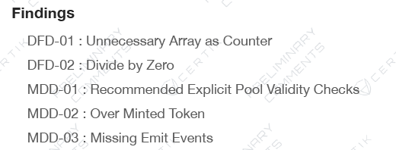

Slide 3
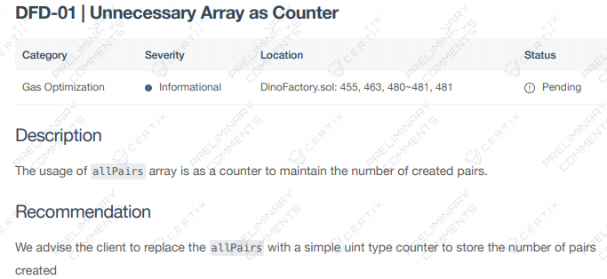
DFD-01: Unnecessary Array as Counter
ACTION TAKEN:
The Dino Defi Devs carefully analyzed the recommendation of the Certik Auidt team to replace the allPairs function with a simple counter. Although Solidity provides no protection against the overflow of allPairs, the probability of an overflow occurring is negligible as Solidity uses the hash of the slot as a starting position for storage arrays. This means that the maximum possible length before integer overflow of the array size will depend, and only depend on the slot number.
In addition, the benefit of using the allPairs array is that it breaks up the access into constant gas pieces, whereas iterating over the array from an external contract would be extremely costly – it would require one call per element.
For the reasons stated above, the DinoDefi team will continue using the allPairs function and we will not be replacing it with a simple counter.

Slide 4
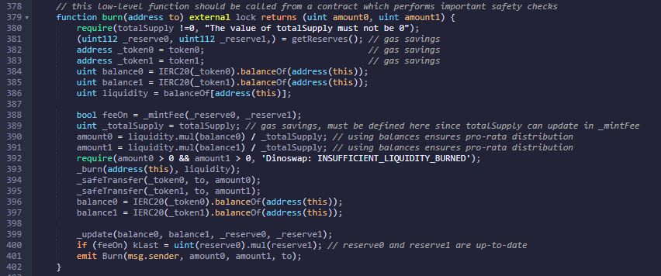
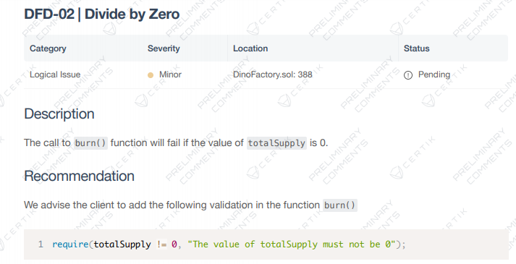
DFD-02: Divide by Zero
Action Taken
The following adjustments were made to the code:

Slide 5
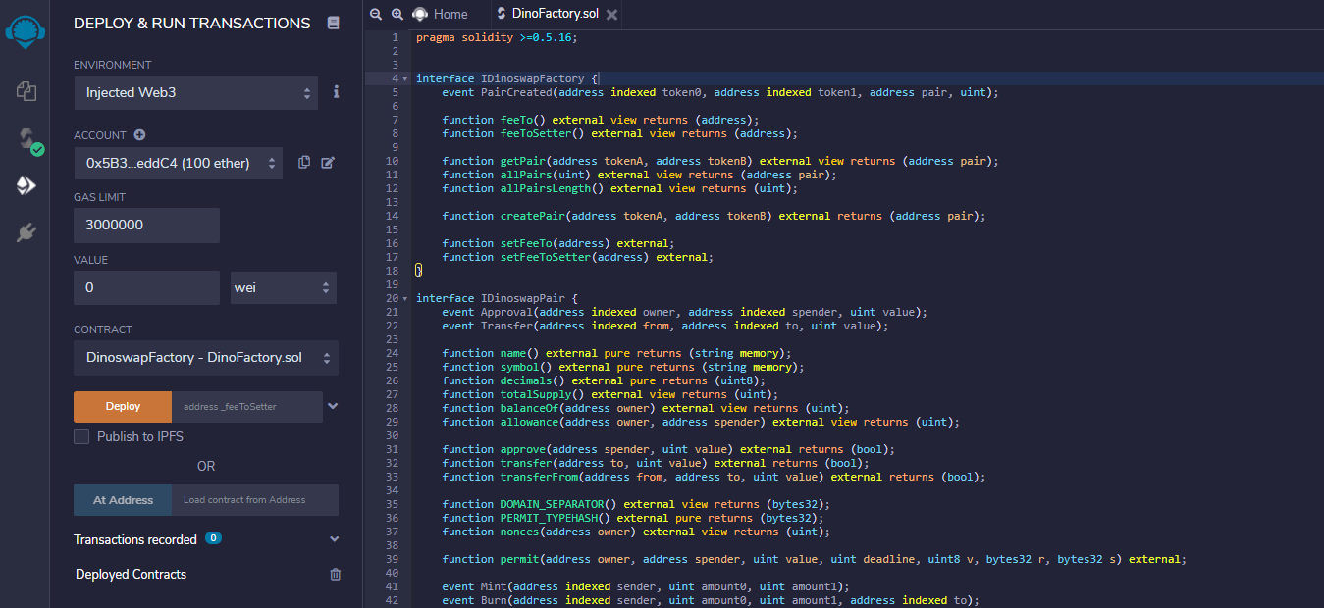
Compile Test

Slide 6
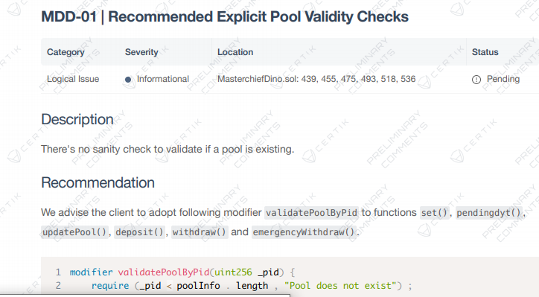

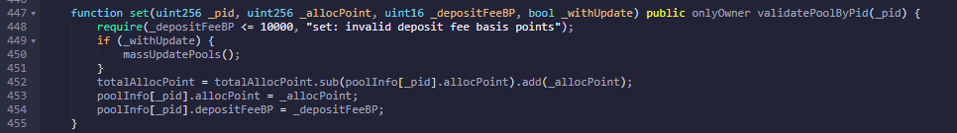
MDD-01

Slide 7
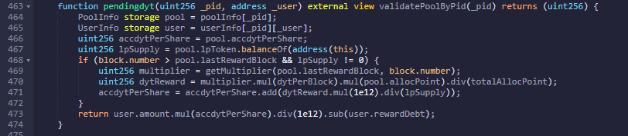
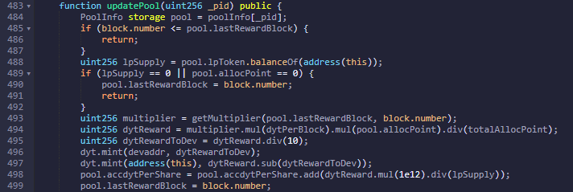
MDD-01

Slide 8
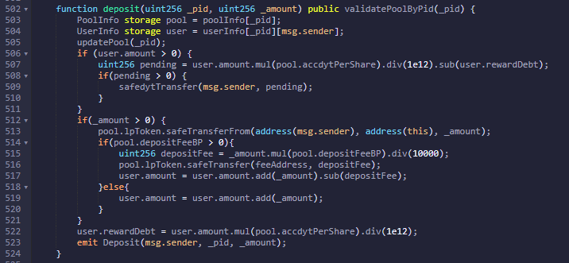
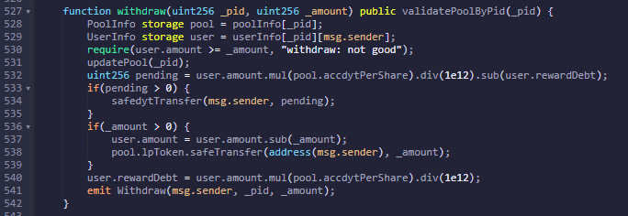
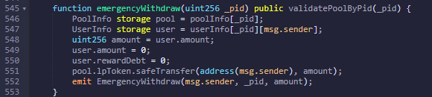
MDD-01

Slide 9
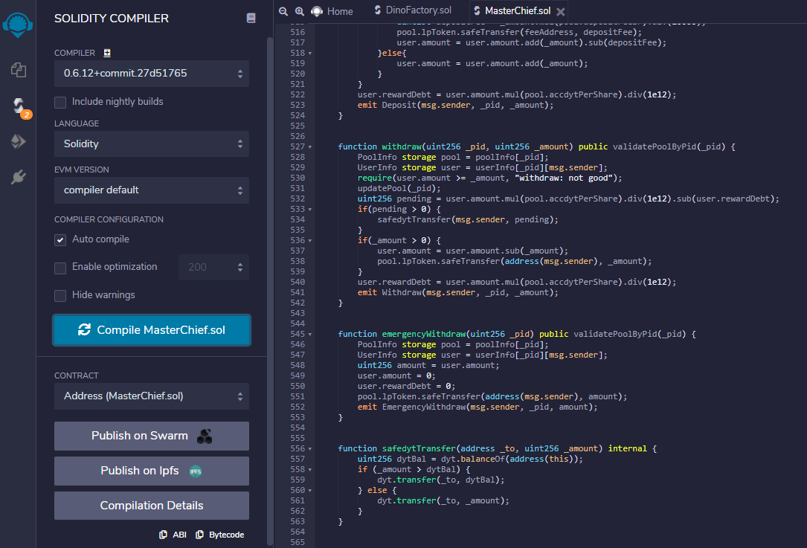
Compile Test

Slide 10
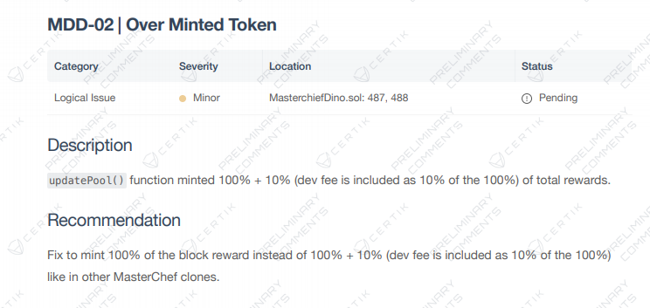
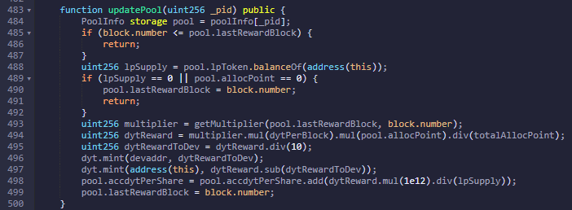
MDD-02

Slide 11
Compile Test

Slide 12
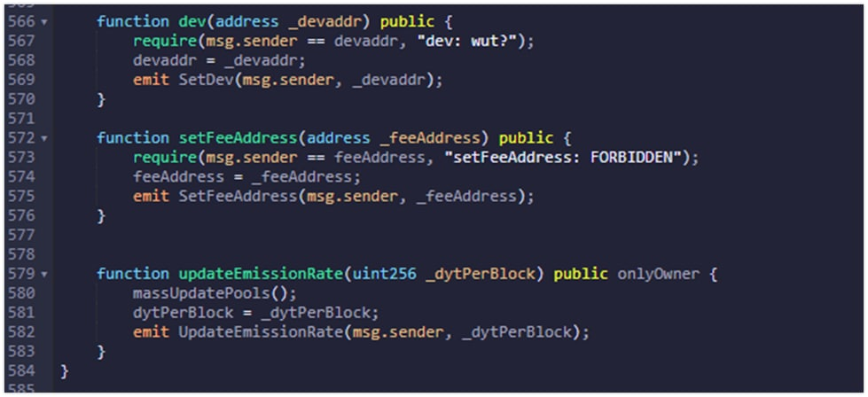
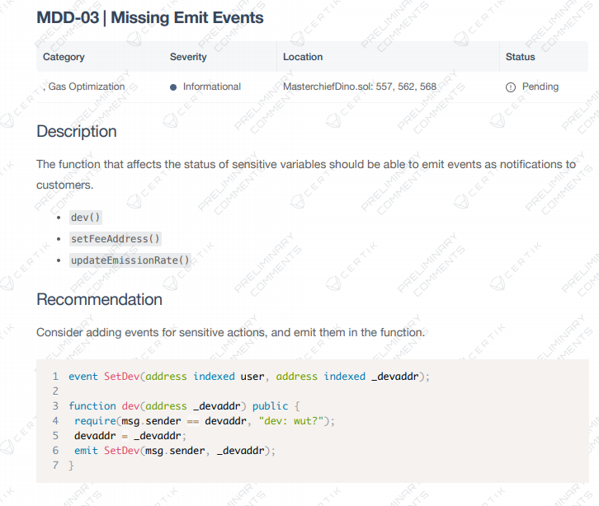
MDD-03

Slide 13
Compile Test

